Slide 1
Deploy Machine Learning Models as a Web Application

Slide 2
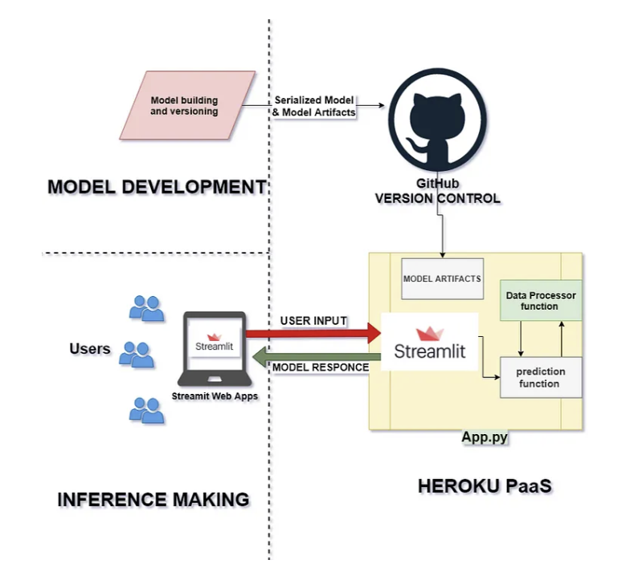
Deployment System Architecture
Localized training
Serialize trained model
Push model to git repo
Run streamlit to host web interface
Use Heroku to host web service

Slide 3
Prerequisites
Anaconda (python 3.8 or greater)
GitHub account
Heroku account(with billing info)
Saleforce Authenticator
Git installed
Heroku CLI installed

Slide 4
Step 1
Download git
https://git-scm.com/download/win
Download Heroku CLI
https://devcenter.heroku.com/articles/heroku-cli

Slide 5
Step 2
Create a GitHub repo
Clone the example repo to your own repo
git clone https://github.com/EthanZhu23/wine-example-app.git

Slide 6
Step 3
Push changes to your repo
git init
git add *
git commit -m "<your commit message>“
git remote add origin "<your remote repository http link>“
git push -u origin master

Slide 7
Step 4
Log in Heroku and deploy
heroku login
heroku create <yourAppName> --stack heroku-20
heroku git:remote -a <yourAppName>
git remote –v
git push heroku master

Slide 8
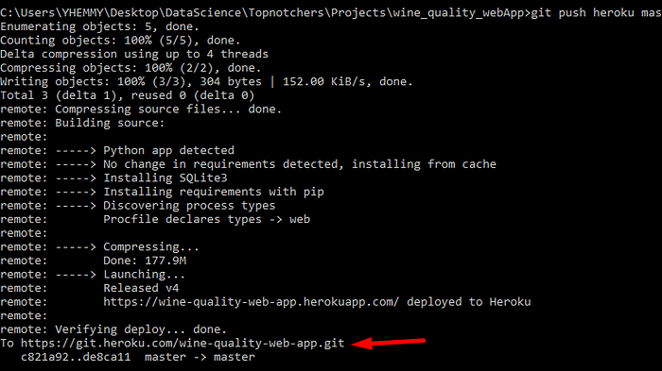
Step 5

